Slide 1


Bimonthly webinar
July 17, 2018

Slide 2
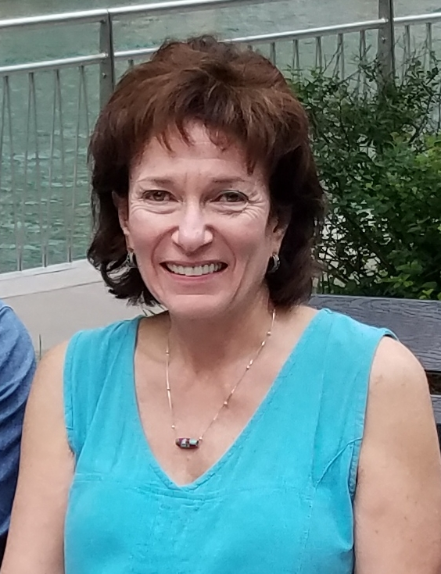
Agenda
Welcome (1-2 minutes)
Ambassador update – Jacki Drexel & Lori Monarca (5-7 minutes)
Federal advocacy update – Emily Lemiska on behalf of Cindy Steinberg (3 minutes)
General updates from other staff (1 minute)
Questions - Open (3 minutes)
“From ow to om: Using mindfulness to reduce pain and stress” – Gwenn Herman (45 minutes)
Questions - Open (5 minutes)

Slide 3
Housekeeping
You can ask questions by typing them into the control panel at right under “Questions”.
  We will answer questions at the end of all the department updates and then during the Q&A
A recording of this webinar will be available on https://uspainfoundation.org/webinars/
Please take our feedback survey at the end!

Slide 4
Ambassador update
Lori Monarca and Jaclyn Drexel,
Co-directors of the Ambassador Network

Slide 5


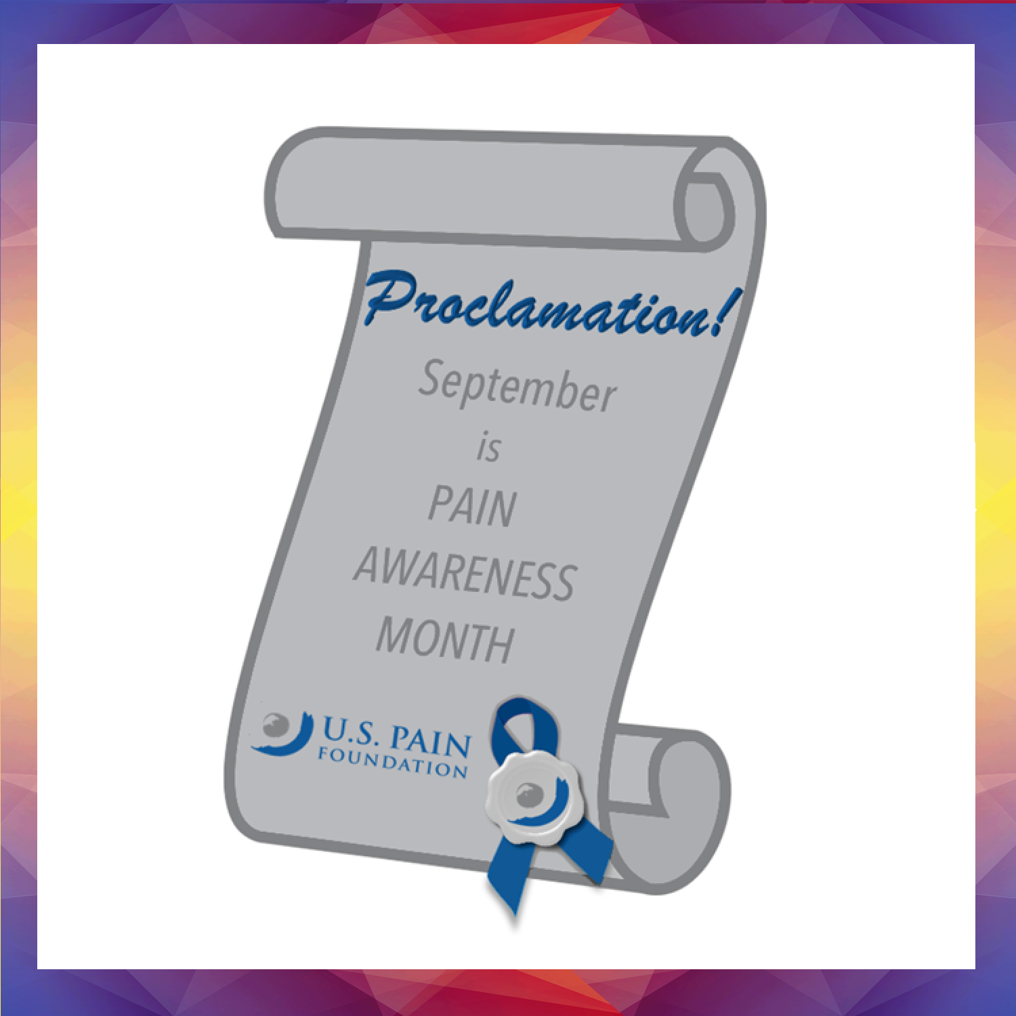

Light up the Landmarks & Proclamations
State Proclamation
  Several Requested
  19 Pending
  4 Approved
Local Proclamation
  Over 40 Requested
  7 Approved
Light up the Landmarks
  Over 200 Contacted!
  40+ Approved!
**Special Note: Awareness Tables & Fundraisers**
Informational materials are limited so contact us soon!

Slide 6

The people of U.S. Pain are pain warriors too!
U.S. Pain was founded by pain patients for pain patients
Each U.S Pain team member will have their pain colors highlighted and shared through a team Invisible Project!

Slide 7
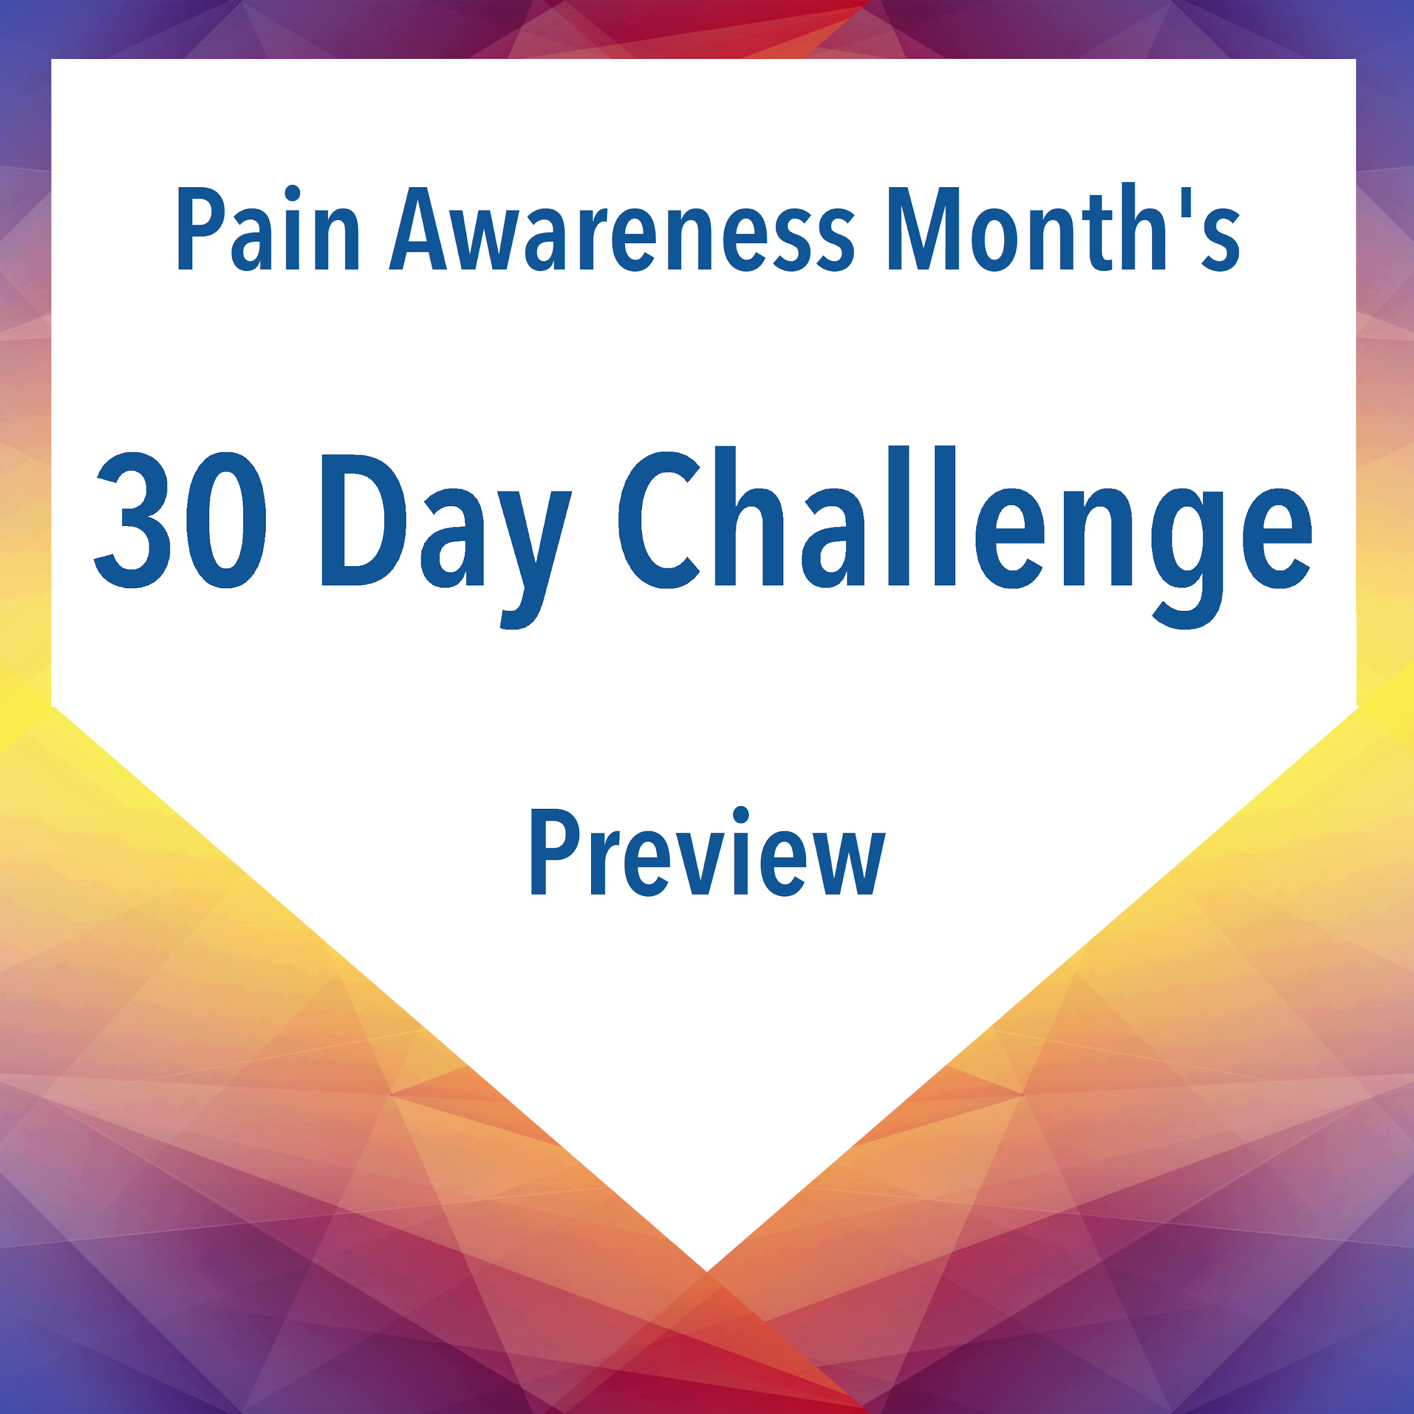
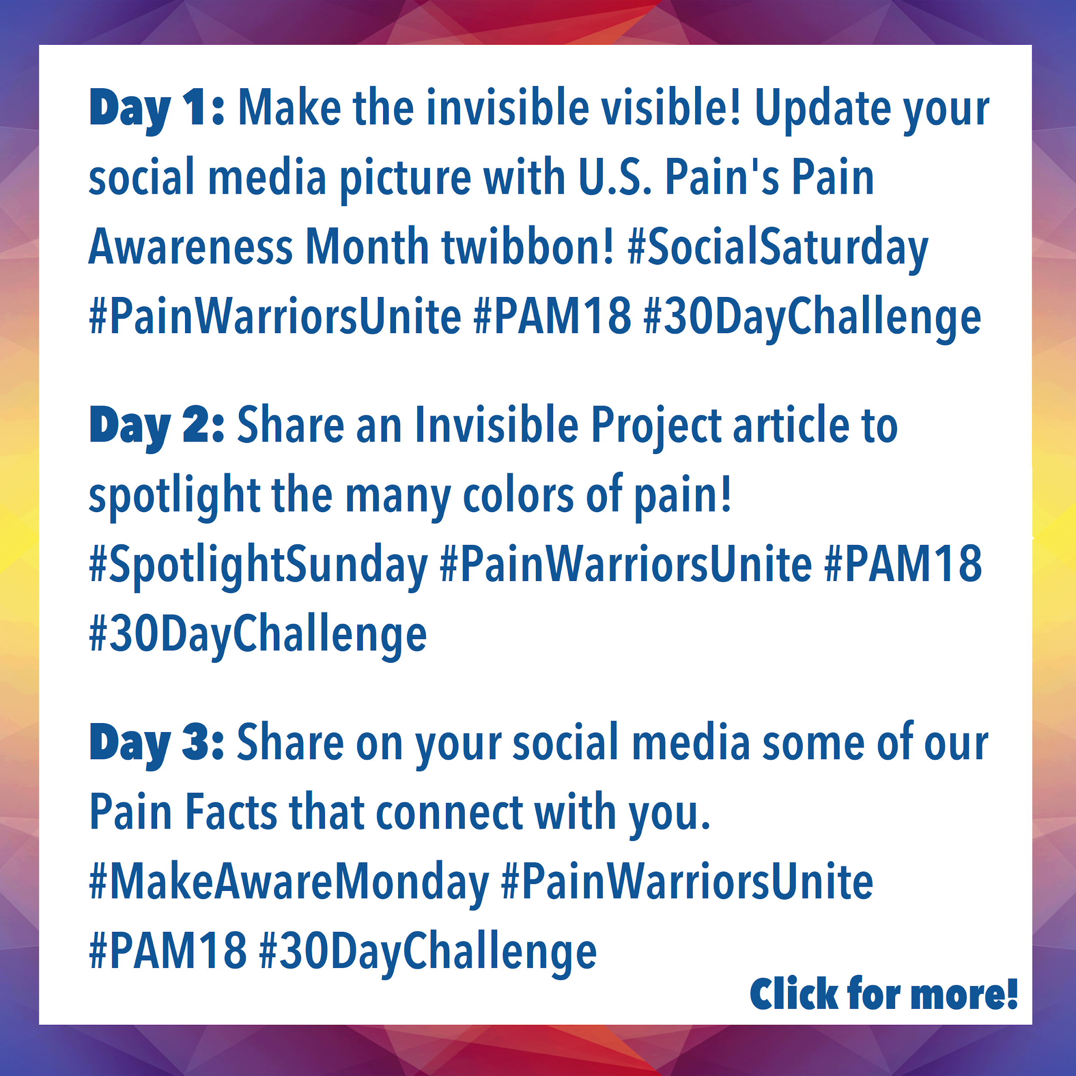
The 30 Day Challenge Sneak Peek!
Access this presentation and click the preview box on the right for the complete challenge list!

Slide 8
Federal advocacy update
Cindy Steinberg
National Director of Advocacy and Policy

Slide 9
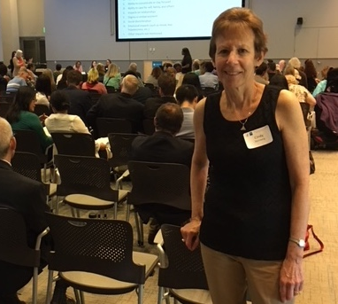
Federal advocacy
-FDA July 9 meeting on chronic pain very successful!
Hundreds of patients participated
Consistent message delivered loud & clear
Pain patients are suffering, cannot find care, abandoned or forced taper from opioid medication that was helping them
`Docket open until Sept. 10 – please write in your story!
We need overwhelming numbers so cannot be ignored – 1,286 so far; we want to see 5,000!
Docket link: https://www.regulations.gov/document?D=FDA-2018-N-1621-0001

Slide 10
Federal advocacy
Federal House passed HR 6 SUPPORT Act Needs Your Attention ASAP!
Many provisions, if remain in bill will be detrimental to pain patients including:
Restricting certain individuals in Medicaid to limited providers & pharmacies
Welcome to Medicare to review opioid use & screen for opioid use disorder
Encourage prioritization of interventional procedures & surgical services above opioids
State reports on daily MME on covered individuals
Hospitals to track opioid prescribing & reduce long-term opioid prescriptions
Encourage limiting use of opioids in ER including collecting data on opioid scripts written in ERs
Medicare to investigate high-volume prescribers & take “corrective action” against “over-prescribers”
Medicare survey of patients may not include questions about how pain was managed unless they also include risks of opioid use
If these concern you, call your federal representatives and senators & tell them you want these provisions removed in a final Congressional Opioid bill

Slide 11
Other staff updates

Slide 12
Other updates
Right now:
  Lots of surveys!
  15 in-person support groups
In the pipeline:
  A Facebook support group
  INvisible Project: osteoarthritis/chronic low back edition
  At least one Take Control of Your Pain event this fall
  Advocacy webinar trainings
  Tentative chronic pain support group leader training in October

Slide 13
Questions?
You can type in questions using the navigation bar at right.
Or, feel free to reach out by email afterward:
  Ambassador program -- lori@uspainfoundation.org & jaclyn@uspainfoundation.org
  State advocacy -- shaina@uspainfoundation.org
  Federal advocacy -- csteinberg@rcn.com
  Fundraising -- fundraising@uspainfoundation.org
  General -- contact@uspainfoundation.org

Slide 14
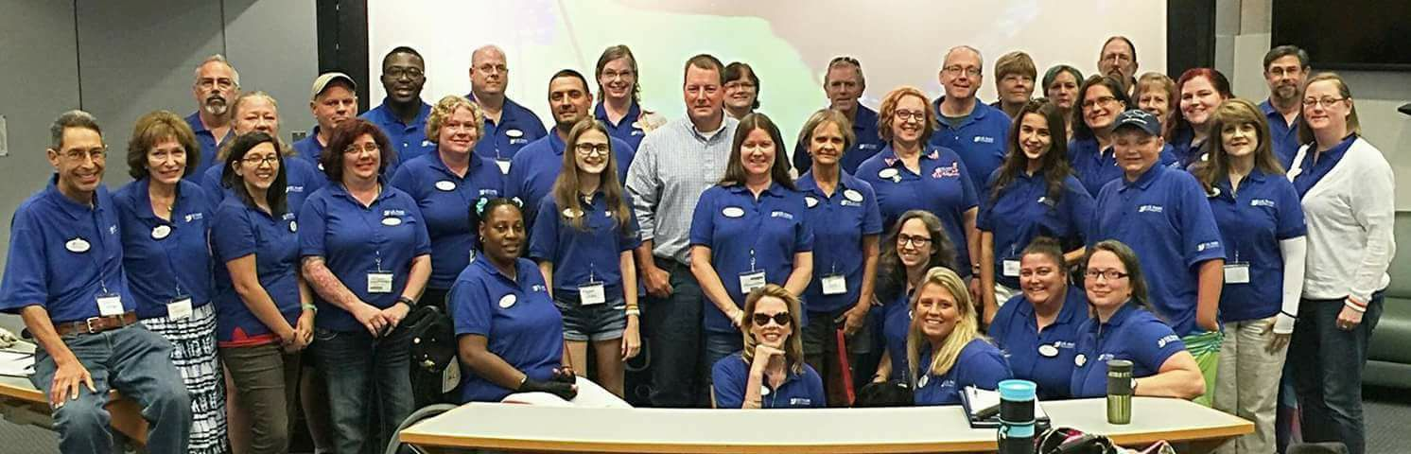
Reminders
If you haven’t signed up as an advocate/ambassador yet, you can do so here: www.uspainfoundation.org/get-involved
To get ambassador credit for attending today’s webinar, visit: https://tinyurl.com/USPainActivity

Slide 15
Keynote presentation
From ow to om: Using mindfulness to reduce stress and pain

Slide 16
Mindfulness Practices
When we get too caught up in the busyness of the world, we lose connection with one another – and ourselves . Jack Kornfield
Gwenn Herman, LCSW, DCSW
WWW.USPAINFOUNDATION.ORG
800-910-0664

Slide 17
Mindfulness Practices
A way of working with the mind and the body to decrease pain and suffering and increase happiness
Usually involves form of meditation
  Formal and Informal Practices
  Buddhist Tradition

Slide 18
Mindfulness
The awareness that emerges through paying attention on purpose, in the present moment, nonjudgmentally to the unfolding of experience moment by moment
Jon Kabat Zinn 2003

Slide 19
What Mindfulness- is not…
Clearing the mind
Becoming non-feeling
Pain free
Always a peaceful experience
Easy
What you think

Slide 20
The Paradigm Shift
If we can really understand the problem, the answer will come out of it, because the answer is not separate from the problem-
J. Krishnamurti
Traditional Based
Reducing or avoiding distress
Moving away from
External Cure
Mindfulness Based
Acceptance and distress awareness
Moving toward
Internal Healing

Slide 21
The Hindrances
(negative mental states that prevent seeing clearly)
Doubt
Aversion (Avoidance/Anger/Busyness)
Desire (Clinging/Craving/Greed)
Restlessness
Sloth/Torpor

Slide 22
Responding with Loving Kindness and Compassion
Mindful attention includes a stance of compassion, interest, friendliness, and open-heartedness toward the experience observed in the present moment, regardless of how pleasant or aversive it may be
        Kabat-Zinn 2003

Slide 23
Responding with Loving kindness and Compassion
Wisdom and Compassion: Two wings of a bird
Wisdom
Awareness of the true nature of the mind
Compassion
Latin “com pati” – to suffer with
“Invisible matrix that holds the entire enterprise together” (Siegel et. al, 2009)
Metta practice

Slide 24
Reconnecting to the body
We know that the mind and body are not separate. There are complex feedback mechanisms between mind and body that assist in maintaining homeostasis and health.
By paying attention we can assist in strengthening these connections.
If we have been using distraction for pain management – we may initially experience an increase in discomfort as we start to pay attention.
Remember to proceed gently when reconnecting to the body. Dip in and out of the sensations by returning to the breath frequently.
Staying with pain without loving-kindness is warfare
(Pema Chodren)

Slide 25
Reconnecting to the body is BASIC
B- Breathing (present moment)
A- Attitude (compassion)
S- Sensations (direct experience of body sensation)
I-Inner sight (look closely and clearly)
C-Choices (reacting vs. responding)

Slide 26
Step one: Breath
Turn inward toward the body and pay attention to the breath
Intersection of the mind and body
Requires stopping -shamatha

Slide 27
Step two: Attitude
Caring Attitude
  Check your compassion level
Staying with pain without loving-kindness is warfare
        Pema Chodren

Slide 28
Attitudinal Factors
Pillars of Mindfulness
Nonjudging
Patience
Acceptance
Letting go
Trust
Beginner’s eyes
Nonstriving

Slide 29
Step three: Sensations
Stay with pure physical sensations
  Become more aware of stories or pain scripts

Slide 30
Physical Sensations
Burning
Throbbing
Aching
Stabbing
Twisting
Ripping
Hot/cold
Dull
Tearing
Cramping
Tight
Pinching
Gnawing
Numb
Stinging
Tingling

Slide 31
Step Four : Inner sight
Looking closely and clearly at body sensations
  Just noticing
  What is really happening?

Slide 32
The Stories:
My life is over
I will always be in agony
I do not make any contribution/I am not important anymore
I can’t live with this
What I have done is unforgivable
I am a burden

Slide 33
Emotional Responses
Fear
Anger
Frustration
Despair
Hopeless
Grief
Blame
Depression
Denial
Regret
Rage
Resistance
Loss
Anxiety
Separation
Shame

Slide 34
What influences our perception of Pain?
Parents
Genetics
Anticipation
Thoughts
Emotions anger, forgiveness
Stress and tension
History of abuse and or trauma

Slide 35
Step Five: CHOICE
Reacting vs. Responding
React
Stress Response
  Muscle tension
Avoidance
Respond
Mindfulness
  Relaxation
  Choice Acceptance/ Equanimity
Emotional and Physical Pain
Maladaptive responses
Increased disability/pathology
Reduces habitual maladaptive responses
Improved quality of life

Slide 36
The Research
Provide clients with key research
  Chronic Pain/Illness (Kabat Zinn 1982, 1985, 1987)
  Chronic Depression (Segal, Williams, & Teasdale, 2002)
  Anxiety (Baer, 2003; Garland, 2007; Kabat Zinn, 1990; Shapiro & Schwartz, 2000)
  Borderline Personality Disorder, Suicidal Ideation (Linehan, 1993)
  Psychotic Delusions (Bach & Hayes, 2002)
  Trauma (Follete & Vijay, 2009)
  Co-occurring addictive and mood disorders (Hoppes, 2006 in Kocovski, 2009)

Slide 37
Research: Neuroplasticity
Changes in Brain Structure and Function
Increased cortical thickness in anterior insular, sensory cortex, prefrontal cortex, and may deter cortical thinning that occurs with age (Lazar, 2005 in Treadway & Lazar, 2009)
Increase in left Hemisphere activity (positive feelings)
  (Davidson et al., 2003, 2008)
Increase in alpha waves (EEG) associated with relaxation
Increased sustained attention, decreased habituation
Increased cingulate cortex (attention, decision making, motivation, motor control)
Insular function (interoception, depression, guilt, pain, plays role in various psychiatric disorders – schizophrenia)
        (Treadway & Lazar, 2009)

Slide 38
Research: State vs. Trait Changes
Increases in trait measures which are usually stable in adulthood
  indicative of enhanced psychological hardiness (Kobasa)
  and greater sense of coherence (Antonovsky) over the course of the eight week intervention, and maintenance of these gains for up to three years of follow-up.
  The latter measures indicate a heightened sense of self and self-in-relationship, and a greater ability to find coherence and act effectively under high degrees of stress These changes enhance the experience of self-efficacy
        (Treadway & Lazar, 2009)

Slide 39
Research: Depression
50% reduction in relapse of major depression for those with at least three prior episodes (Seigel et al., 2002)
Actively depressed and anxious (Finucane & Mercer, 2006 in Kocovski et al., 2009)
Treatment resistant actively depressed (Kenny and Williams, 2007 in Kocovski, 2009)

Slide 40
Research: Anxiety
Anxiety and/or panic [Kabat-Zinn et al, 1992; Miller et al, 1995], over the eight weeks of the MBSR intervention, and maintenance of these changes in some cases for up to four years of follow-up

Slide 41
Research: Pain
Dr. Jackie Gardiner-Nix (2007)
  Decrease in pain “catastrophizing”
  Increase quality of life
  Increased acceptance of limits
  Improved social functioning
  Reduced body pain
  Some improved functioning

Slide 42
Research: Pain
Jon Kabat-Zinn (1982,1987) Long term benefits for Chronic Pain patients
  Reduction in pain levels and pain related behaviors
  Attitudinal and behavioral changes
    Ability to observe mental events including pain with a sense of detachment
    Increased awareness of self in relation to the world
    Personal insights
    Greater patience
    Ability to relax in daily life situations
    Increased awareness of stressful situations and improved ability to cope

Slide 43
Research
Acceptance techniques used in ACT (such as observing and accepting thoughts and feelings as they are) produce greater tolerance of acute pain and discomfort than do more traditional techniques of pain control such as distraction and cognitive restructuring
  (Gutierrez, Luciano, Rodriquez, & Fink, 2004; Hayes et al, 1999; Levitt, Brown, Orsillo, & Barlow, 2004)

Slide 44
Research
Acceptance of pain correlated with:
  Lower self-rated pain intensity
  Less self-rated depression and pain related anxiety
  Greater physical and social ability
  Less pain avoidance
  Better work status
        (McCracken et al., 2004 in Baer et al., 2006)

Slide 45
A SPECIAL THANK – YOU TO:
MARY FRENCH, RN, LCSW-C, FOR PERMISSION TO USE HER SLIDES. WWW.MARYFRENCH.COM

Slide 46
SELF-COMPASSION BREAK
Bring to mind an interaction with someone that makes you feel badly—only moderately badly so that you can feel the stress in your body but not get overwhelmed by it. Visualize the situation until it makes you a little uncomfortable.
Now, say to yourself:
This is a moment of suffering (mindfulness)
Suffering in a part of life (common humanity)
Put your hands over your heart, feel the warmth of your hands, the gentle pressure of your hands, and notice your chest rhythmically rising and falling beneath your hands.
Now, say to yourself:
May I be kind to myself (self-kindness)
May I accept myself just as I am

Slide 47
SELF-COMPASSION BREAK
For the last one or two phrases, use whatever words speak to your particular situation, such as:
May I be safe
May I forgive myself
May I be happy and free from suffering
May I safely endure this pain
May I find peace in my heart
May I be strong
May I protect myself
May I learn to live with ease and well-being
May I accept the circumstances of my life
May we learn to live together in peace

Slide 48
RESOURCES
Books:
Full Catastrophe Living: Using the Wisdom of Your Body and Mind to Face Stress, Pain, and Illness. Second Edition, Revised and Updated. By Jon Kabat-Zinn
Radical Acceptance: Embracing Your Life With the Heart of a Buddha, by Tara Brach
Relaxation Response, by Herbert Benson, M.D. and M. Klipper
How to Meditate: A Guide to Self Discovery, by Dr. Lawrence Le Shan
Making the Invisible Visible: Chronic Pain Manual for Health Care Providers, by Gwenn Herman and Mary French.
Art of Happiness: A Handbook for Living, by the 14th Dalai Lama and H. Cutler
Healing Anger: The Power of Patience from a Buddhist Point of View, by the 14th Dalai Lama and Geshe Thupten Jimpa.
Energy Medicine, by Donna Eden and David Feinstein
Conquest of Mind, by Eknath Easwaran
The Healing Power of Mind, by Tulku Thondup
Electrolytes and the Spark of Life: The Key to Longevity and Quality of Life, by Gillian Marthew
Pain Free: A Revolutionary Method for Stopping Chronic Pain, by Pete Egoscue and Roger Gittines
The History of Pain, by Roselyne Rey
The Origin of Illness, by Norberto R. Keppe
The Wisdom of No Escape and the Path of Loving Kindness, by Pema Chödrön
Macroelements, Water, and Electrolytes in Sports Nutrition, by Judy Anne Driskell, Ira Wolinsky (Editor)
Fibromyalgia & Chronic Myofascial Pain Syndrome ­ A Survival Manual, by Devin Starlanyl, M.D. & Mary Ellen Copeland, MS, MA
The Chronic Pain Control Workbook, 2nd edition, by Ellen Mohr Catalano, MA, & Kimeron N. Hardin
U.S. Pain Foundation does not endorse any of the above links - we are supplying them for informational purposes only.

Slide 49
RESOURCES
Relaxation/Meditation CDs:
“Canyon Trilogy: Native American Flute Music” by R. Carlos Nakai
“Quiet Heart/Spirit Wind” by Richard Warner
“In the Presence of Angels” by Dik Darnell
“The Sounds of Source” by Synchronicity/Master Charles
“Soma: An Experience in Psychoacoustic Healing” by Tom Kenyon, MA
“Higher” by Metamusic/Monroe Institute
“DreamCatcher” by Kevin Locke
Websites
https://www.mindfulnesscds.com/pages/books-by-jon-kabat-zinn
Insight Meditation Community Washington DC www.imcw.org
Tara Brach https://www.tarabrach.com/store/
Apps
Five Free Mindfulness Apps Worthy of Your Attention
https://www.mindful.org/free-mindfulness-apps-worthy-of-your-attention
Insight Timer.
Aura.
Omvana.
Stop, Breathe & Think.
Ouchie
U.S. Pain Foundation does not endorse any of the above links - we are supplying them for informational purposes only.

Slide 50
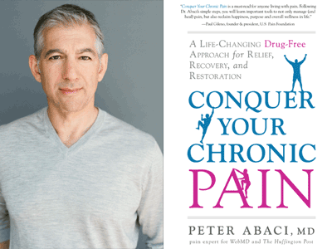
Next webinar
Next volunteer webinar will be Sept. 18 at 1 pm EST with Peter Abaci, MD
Registration link will be available soon – check your inbox for updates!
Thanks for joining us!

